Slide 1
Twitter Sentiment Analysis On Stock Price
Presented by :-
Susmita Mukherjee (10400118003)
Ankush Kumar(12017002002027)
Under the Guidance of
Prof. Bavrabi Ghosh

Slide 2
Contents
Problem Statement
Introduction
Literature Review
Proposed Methodology
Data for experimentation
Obtained result
Future work
References

Slide 3
Problem Statement
Stock exchange is a subject that is highly affected by economic, social, and political factors. There are several factors e.g. external factors or internal factors which can affect and move the stock market.
The changes in stock prices of a company, the rises and falls, are correlated with the public opinions being expressed in tweets about that company. Understanding author’s opinion from a piece of text is the objective of sentiment analysis.
Positive news and tweets in social media about a company would definitely encourage people to invest in the stocks of that company and as a result the stock price of that company would increase.
In this project our aim is to predict weather stock price will increase or decrease based on tweets about that company.

Slide 4
Introduction
Stock price prediction is one of the most important topic to be investigated in academic and financial researches. Various Data mining techniques are frequently involved in the studies.
But technique using machine learning/deep learning will give more accurate, precise and simple way to solve such issues related to stock and market prices. On social media, the information about public feelings has become abundant.
Social media is transforming like a perfect platform to share public emotions about any topic and has a significant impact on overall public opinion.
Twitter, a social media platform, has received a lot of attention from researchers in the recent times. Twitter is a micro-blogging application that allows users to follow and comment other user’s thoughts or share their opinions in real time. More than million users post over 140 million tweets every day.
This situation makes Twitter like a corpus with valuable data for researchers. Each tweet is of 140 characters long and speaks public opinion on a topic concisely. The information exploited from tweets are very useful for making predictions.
Sentiment analysis of twitter data and sentiment classification is the task of judging opinion in a piece of text as positive, negative or neutral. In this project a method for predicting stock prices is developed using Twitter tweets about various company.
Sentiment analysis of the collected tweets is used for prediction model for finding and analysing correlation between contents of news articles and stock prices and then making predictions for future prices will be developed by using machine learning

Slide 5
Literature Review
■ Studied different types of algorithms and analysed stock price prediction methodogies of different author Predicting Stock Market Movements using twitter sentiment analysis
■ Data Set : Here we have discussed about different types of data set like - Dow Jones Industrial Average (DJIA) values from June 2009 to December 2009, Tweets were collected for over the period from October 2 th, 2017 to October 24th, 2017 from Microsoft Company extracted from Twitter API.
■ Algorithm : We analysed algorithms like - Naive Bayes-Support Vector Machine, Supervised Machine Learning Model using Lexical method etc.

Slide 6
Proposed Methodology
Imported .csv dataset (with pandas) and performed tokenization with TFID Vectorizer
Prepared matrix of features and split this matrix into training and test set .
Performed supervised Machine Learning ( both Naïve-Bayes and Random Forest ) using the data
Use this model to predict output from test data (unlabelled ) .
Build Confusion Matrix and anaylsed accuracy score
Performed a comparative analysis of both models

Slide 7
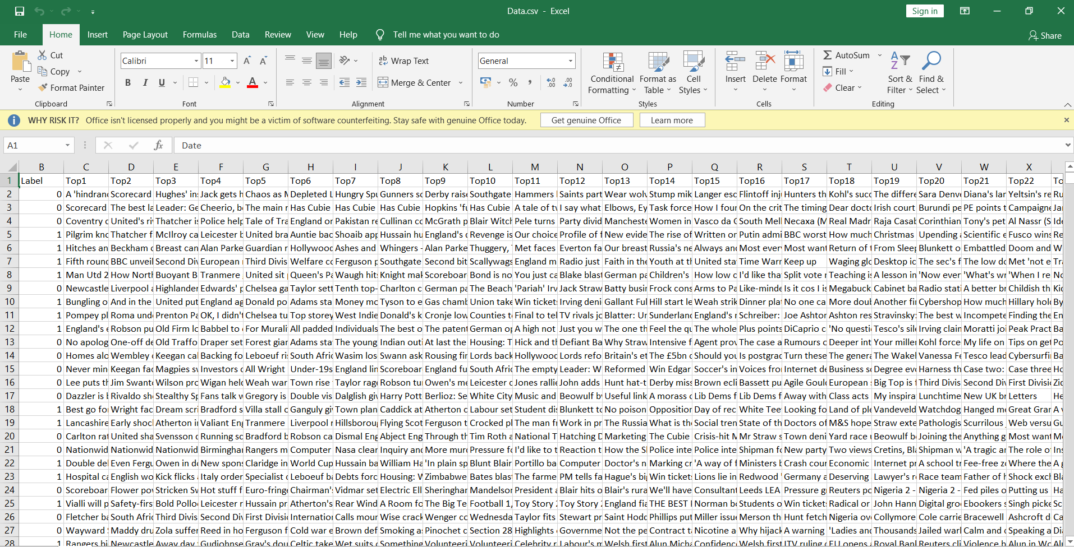
Dataset
We prepared training data from a .csv data having a total of 27 features . No feature discarded .

Slide 8
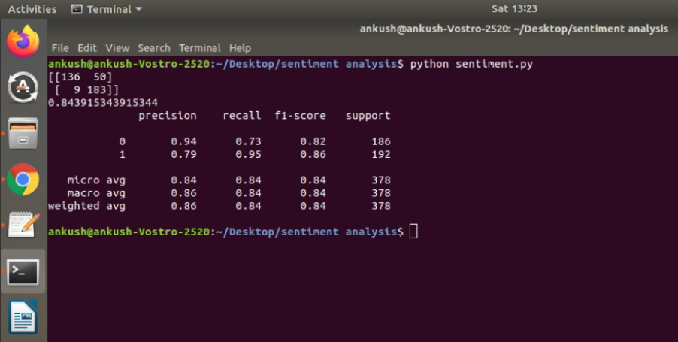
Obtained result
We ran program in python and obtained the following :

Slide 9
Current status and Future Work
Currently trying to use Tweepy and TextBlob to connect to Twitter application for getting live tweets
We need to improve model accuracy by feature extraction
In future , Need to use deep learning techniques like RNN ( Recurrant Neural Networks ) for better results in terms of accuracy
In future , Need to automate the process on a server such as AWS or Microsoft Azure

Slide 10
References
https://www.analyticsvidhya.com/blog/2018/10/predicting-stock-price-machine-learningnd-deep-learning-techniques-python/
https://towardsdatascience.com/
Repository link :
https://github.com/ankush510/Twitter-Sentiment-Analysis

Slide 11
Thank You !

